Slide 1
Breaking down the code: Wage equity in software engineering
A Data-Driven Analysis of Salary Patterns
Notes:
This presentation delivers a comprehensive data-driven analysis of salary disparities within the tech industry, emphasizing the ongoing wage gaps that exist even in a sector renowned for it innovation and progress

Slide 2

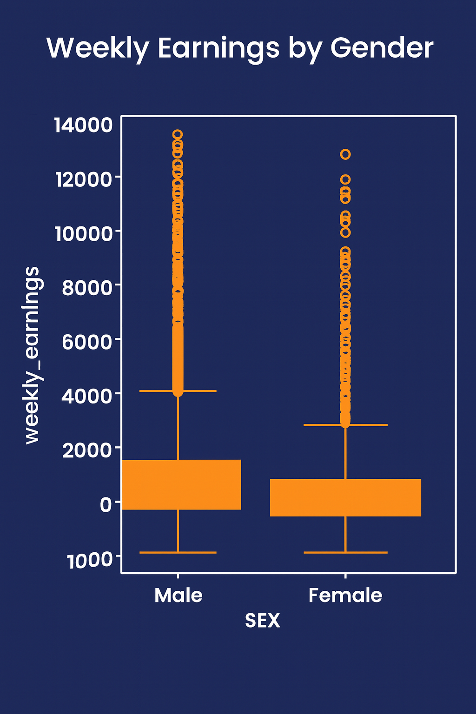

In an industry driving innovation, wage gaps persist
Notes:
Despite being at the forefront of technological advancement, the tech industry still faces significant wage disparities. The average salary for males in software engineering is $177,861, compared to $145,974 for females, leading to gender wage gap of $31,887

Slide 3
18% Gender Wage Gap
The gender wage gap in the tech industry stands at 18%, highlighting a crucial area that required attention and action to promote equity and fairness in compensation across a sample of 1000 employees

Slide 4

Our Journey and Challenges
1
2
3
4
Initial Analysis
Data Collection Challenges
Focus on Software Engineering
Dashboard Development
Commenced with a broad wage analysis across various sectors to understand general salary patterns in the tech industry, leading to the discovery of wage gaps
Encountered significant challenges in data collection, including inconsistencies and gaps in available salary data, requiring innovative solutions
Refined the research focus specifically to the software engineering sector, aiming for more targeted analysis of wage equity
Culminated in the design and development of a comprehensive dashboards that visualizes salary data making insight accessible

Slide 5
Education Impact of Compensation
$181,871
$181,127
$159,743
Bachelors
While lower than their graduate counterparts, still reflects a competitive wage within the industry
PHD
Individuals with a PhD command the highest salaries in the software engineering field. This highlights the importance of advanced education in achieving higher remuneration
Masters
Those holding a master’s degree also earn significant salaries. Demonstrating a strong return on educational investment in the tech industry

Slide 6


Boston: Leading The Park
San Francisco: The Contender

Slide 7

Impact and Next Steps
Enhancing data collection with additional variables
01.
Expanding the methodological approach
02.
Developing concrete policy recommendation
03.
Engaging with Industry Stakeholders
04.
Extending the research to address identified gaps
05.

Slide 8
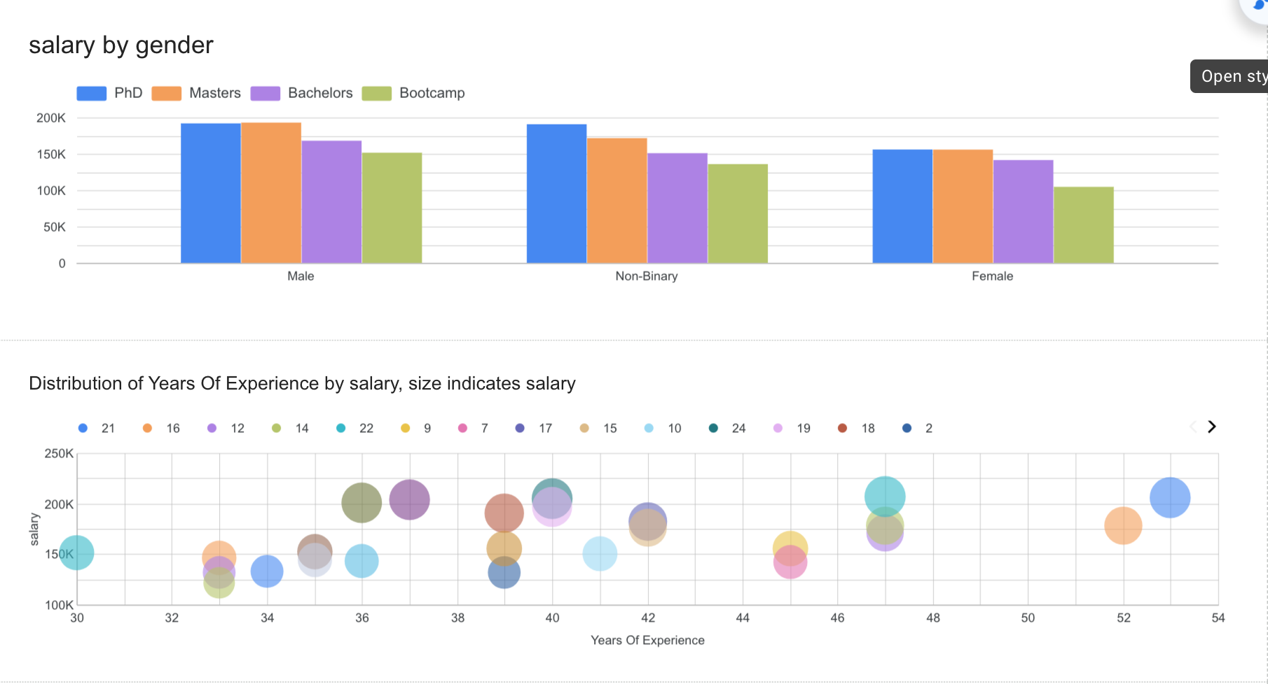
Our Dashboard
Link: https://lookerstudio.google.com/reporting/f257487a-f01d-49b7-945c-48858306a50b

Slide 9


Thank You!

